Slide 1

AgeX Shipping Company Data Analysis
Presenter
Ogunleke Abdullah Samson

Slide 2
Outlines
Introduction
Entity Relationship Diagram
Question
SQL Query and Approach Logic
Results
Presentation Title

Slide 3

Overview
AgeX Shipping Company is a global logistics firm that began its operations in February 2020.
The company's primary business revolves around shipping packages between the USA, Canada, and Nigeria.
This project analyzed AgeX Shipping Data using the collected data on their customers and shipping orders to provide valuable business insights.

Slide 4
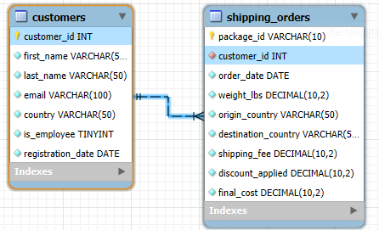
Entity Relationship Diagram(ERD)

Slide 5
1. Total Customers: Write a query to find the total number of customers registered with AgeX.

Slide 6

/* The total number of customers who have registered with AgeX. */ -- SQL query code: SELECT count(customer_id) as total_customers from customers; -- Query logic: Aggregate function count with alias.
SQL Query and Approach Logic

Slide 7
2. Customers Who Have Shipped: Find the total number of unique customers who have placed at least one shipping order.

Slide 8

/* Total unique Customers who have placed at least one shipping order. */ -- SQL query code: SELECT count(distinct(customer_id)) as ordered_customers from shipping_orders; -- Query logic: Aggregate function distinct count with alias
SQL Query and Approach Logic

Slide 9
3. Customers Without Orders: Find the names of all customers who are registered but have not placed any shipping orders.

Slide 10
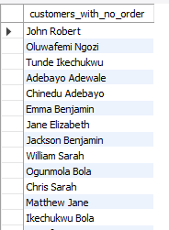
/* The names of all customers who are registered but have not placed any shipping orders. */ -- SQL query code: select concat(first_name, ' ', last_name) as customers_with_no_order from customers left join shipping_orders on shipping_orders.customer_id = customers.customer_id where shipping_orders.customer_id is null; -- Query logic: Concatenation with alias, left join, on, where, and is null clause
. .
. .
. .
SQL Query and Approach Logic

Slide 11
4. Employee Discounts: Find the total amount of money AgeX has given in discounts to its employees.

Slide 12

/* The total amount of money AgeX has given in discounts to their employees. */ -- SQL query code: select sum(discount_applied) as total_discount from shipping_orders; -- Query logic: Summation operator with alias
SQL Query and Approach Logic

Slide 13
5. Customers by Region: Show the total number of customers located in each country.

Slide 14

/* The total number of customers located in each country. */ -- SQL query code: select country, count(customer_id) as total_customer from customers group by country; -- Query logic: Aggregate function count with alias and Group by sorting clause.
SQL Query and Approach Logic

Slide 15
6. Sales by Region: Calculate the total sales (final cost) generated by shipments originating from each country.

Slide 16

/* The total sales (final cost) generated by shipments originating from each country. */ -- SQL query code: select origin_country, sum(final_cost) as total_cost_generated from shipping_orders group by origin_country; -- Query logic: Summation operation with alias and Group by sorting clause.
SQL Query and Approach Logic

Slide 17
7. Sales by Destination: Calculate the total sales for packages shipped to each destination country.

Slide 18

/* The total sales for packages shipped to each destination country. */ -- SQL query code: select destination_country, sum(final_cost) as total_sales from shipping_orders group by destination_country; -- Query logic: Summation operation with alias and Group by sorting clause.
SQL Query and Approach Logic

Slide 19
8. Sales Over Time: Find the total sales for each year since the company started.

Slide 20
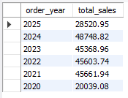
/* The total sales for each year since the company started. */ -- SQL query code: select year(order_date) as order_year, sum(final_cost) as total_sales from shipping_orders group by year(order_date) order by year(order_date) desc; -- Query logic: Year with alias, summation function with alias, group by and order by (descending) sorting clause.
SQL Query and Approach Logic

Slide 21
9. Average Shipping Cost: What is the average shipping cost per pound (weight_lbs) for packages from each origin country?

Slide 22

/* The average shipping cost per pound (weight_lbs) for packages from each origin country? */ -- SQL query code: select origin_country, avg(shipping_fee/weight_lbs) as avg_shipping_fee_per_pound from shipping_orders group by origin_country; -- Query logic: Aggregate function Average with alias and group by sorting clause.
SQL Query and Approach Logic

Slide 23
10. Most Expensive Order: Find the package_id and the final_cost of the most expensive order in the database.

Slide 24

/* The package_id and the final_cost of the most expensive order in the database. */ -- SQL query code: select package_id, final_cost from shipping_orders where final_cost = (select max(final_cost) from shipping_orders); -- Query logic: Where clause and aggregate function maximum
SQL Query and Approach Logic

Slide 25
11. High-Value Customers: Find the customer_id and the total amount they have spent for all customers who have spent more than $500 in total. Order the results from the highest spender to the lowest.

Slide 26
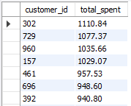
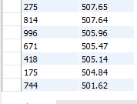
/* The customer_id and the total amount they have spent for all customers who have spent more than $500 in total. The results was ordered from the highest spender to the lowest. */ -- SQL query code: select customer_id, sum(final_cost) as total_spent from shipping_orders group by customer_id having sum(final_cost) > 500 order by total_spent desc; -- Query logic: Summation operator with alias, having clause, group by, and order by (descending) sorting clause.
. .
. .
. .
SQL Query and Approach Logic

Slide 27
12. Sales from Specific Region: What is the total revenue generated from shipments originating in Nigeria and destined for Canada?

Slide 28

/* The total revenue generated from shipments originating in Nigeria and destined for Canada? */ -- SQL query code: select origin_country, destination_country, sum(final_cost) as total_revenue from shipping_orders where origin_country = 'Nigeria' and destination_country = 'Canada'; -- Query logic: Summation operator with alias, where (with and) clause
SQL Query and Approach Logic

Slide 29
13. Employee's Sales: Find the total sales generated by employee shipments, but only for orders that weigh more than 30 lbs.

Slide 30

/* The total sales generated by employee shipments, but only for orders that weigh more than 30 lbs. */ -- SQL query code: select sum(final_cost) as total_employee_sales from shipping_orders join customers on customers.customer_id = shipping_orders.customer_id where is_employee = 1 and weight_lbs > 30; -- Query logic: Summation operator with alias, join, on, and where (with and) clause
SQL Query and Approach Logic

Slide 31
14. Popular Routes: Find the top 3 most popular shipping routes (from origin_country to destination_country) and the number of packages sent on each route.

Slide 32

/* The top 3 most popular shipping routes (from origin_country to destination_country and the number of packages sent on each route. */ -- SQL query code: select origin_country, destination_country, count(package_id) as total_package from shipping_orders group by origin_country, destination_country order by total_package desc limit 3; -- Query logic: Aggregate function count with alias, group by, order by with limit (sorting clause)

Slide 33
15. Customers with Specific Names: Find all customers whose last name starts with the letter 'O'.

Slide 34
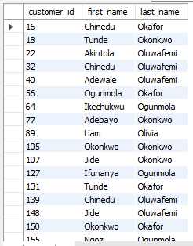
/* All customers whose last name starts with the letter 'O'. */ -- SQL query code: select customer_id, first_name, last_name from customers where last_name like 'o%'; -- Query logic: where clause with wildcard.
SQL Query and Approach Logic

Slide 35
16. Package Tracking: Create a single column that combines the package_id, origin_country, and destination_country into a readable string, for example: Package US-ABCD from USA to Nigeria.

Slide 36
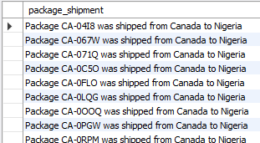

/* A single column that combines the package_id, origin_country, and destination_country into a readable string, for example: Package US-ABCD from USA to Nigeria */ -- SQL query code: select concat('Package', ' ', package_id, ' ', 'was', ' ', 'shipped', ' ', 'from', ' ', origin_country, ' ', 'to', ' ', destination_country) as package_shipment from shipping_orders; -- Query logic: Concatenation with alias
. .
. .
. .
. .
. .
. .
. .
. .
. .
. .
. .
. .
SQL Query and Approach Logic

Slide 37
17. Top Spenders by Country: Find the top 5 customers in the USA based on their total spending. Show their full name and the total amount spent.

Slide 38
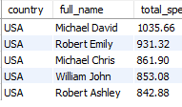
/* The top 5 customers in the USA based on their total spending with their respective full name. */ -- SQL query code: select country, concat(first_name, ' ', last_name) as full_name, sum(final_cost) as total_spent from customers join shipping_orders on customers.customer_id = shipping_orders.customer_id where country = 'USA’ group by customers.customer_id order by total_spent desc limit 5; -- Query logic: Concatenation with alias, summation operator with alias, join, on, where, group by, order by (descending with limit) sorting clause
SQL Query and Approach Logic

Slide 39
Results
AgeX Shipping Company has 181 customers in Canada, 446 customers in USA, and 373 in Nigeria which are 1,000 customers in total. 784 customers out of them have placed at least one shipping order while the rest 216 customers have not placed any shipping order.
They employed 50 customers as their employee with a reward of discounted price, and the total sum of discounted price given to all them so far is amount to ($)1,373.36
The total amount of sales is ($) 233,943.49. Its breakdown is as follow:
Total sales by Region are ($)48,704.30 from Canada, ($)83,179.32 from Nigeria, and 102,059.87 from USA.
Also, their total sales by Destination are ($)150,764.17 to Nigeria, ($)40,184.47 to USA, ($)42,994.85 to Canada.
According to total sales in each years, they earned ($)28,520.95 in 2025, ($)48,748.82 in 2024, ($)45,368.96 in 2023, ($)45,603.74 in 2022, ($)45661.94 in 2021, and ($)20,039.08 in 2020.

Slide 40
Results
The average shipping cost per pound (weight lbs) for packages from Canada is ~($)7, Nigeria is ~($)6, and USA is ~($)6
The most expensive Package ID ordered is CA-FJUF with amount of ($)349.65
The top 3 high value customers are as follows: customer with Customer ID - 302 spent ($)1,110.84, Customer ID - 729 spent ($)1,077.37, and Customer ID - 960 spent ($)1,035.66.
The top 3 most popular shipping routes are shipping from USA to Nigeria with total package of 668, shipping from Nigeria to Canada with total package of 284, and shipping from Canada to Nigeria with total package of 277.
They have 114 records of customers that their last name start with ‘O’.
The top 5 customers in the USA based on their total spending are Michael David spent ($)1,035.66, Robert Emily spent ($)931.32, Michael Chris spent ($)861.90, William John spent ($)853.08, and Robert Ashley spent ($)842.88

Slide 41
Thank you

